Slide 1
St. Louis Building Permits
Monthly Report: January 2020 Washington University Medical Center

Slide 2
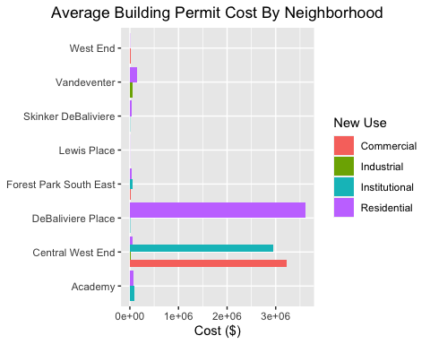
Neighborhood Summary

Slide 3
Academy
6 building permits in Academy in January 2020

Slide 4
new_use | avg_cost | permit_count
Institutional | 100000 | 1
Residential | 82990 | 5

Slide 5
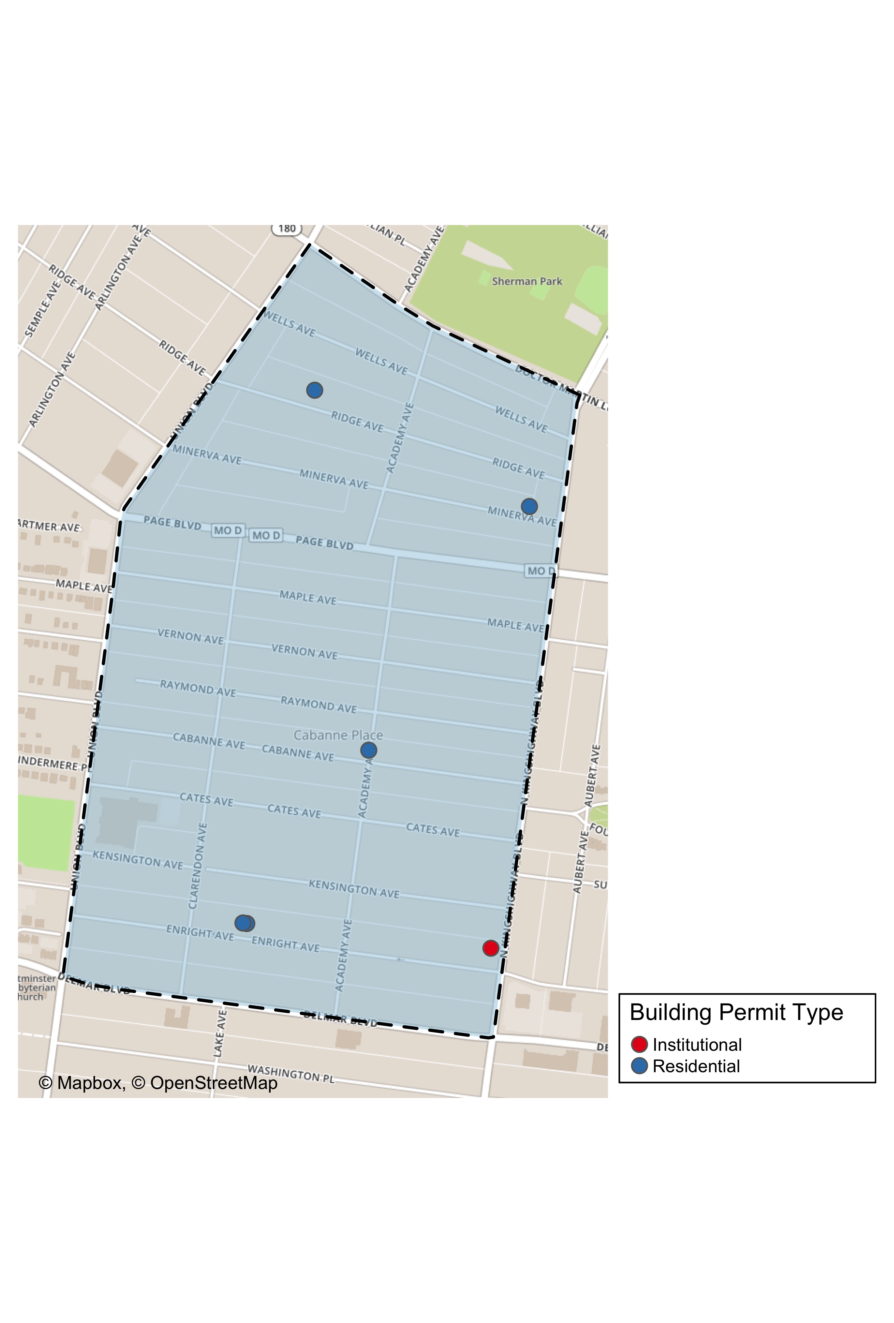

Slide 6
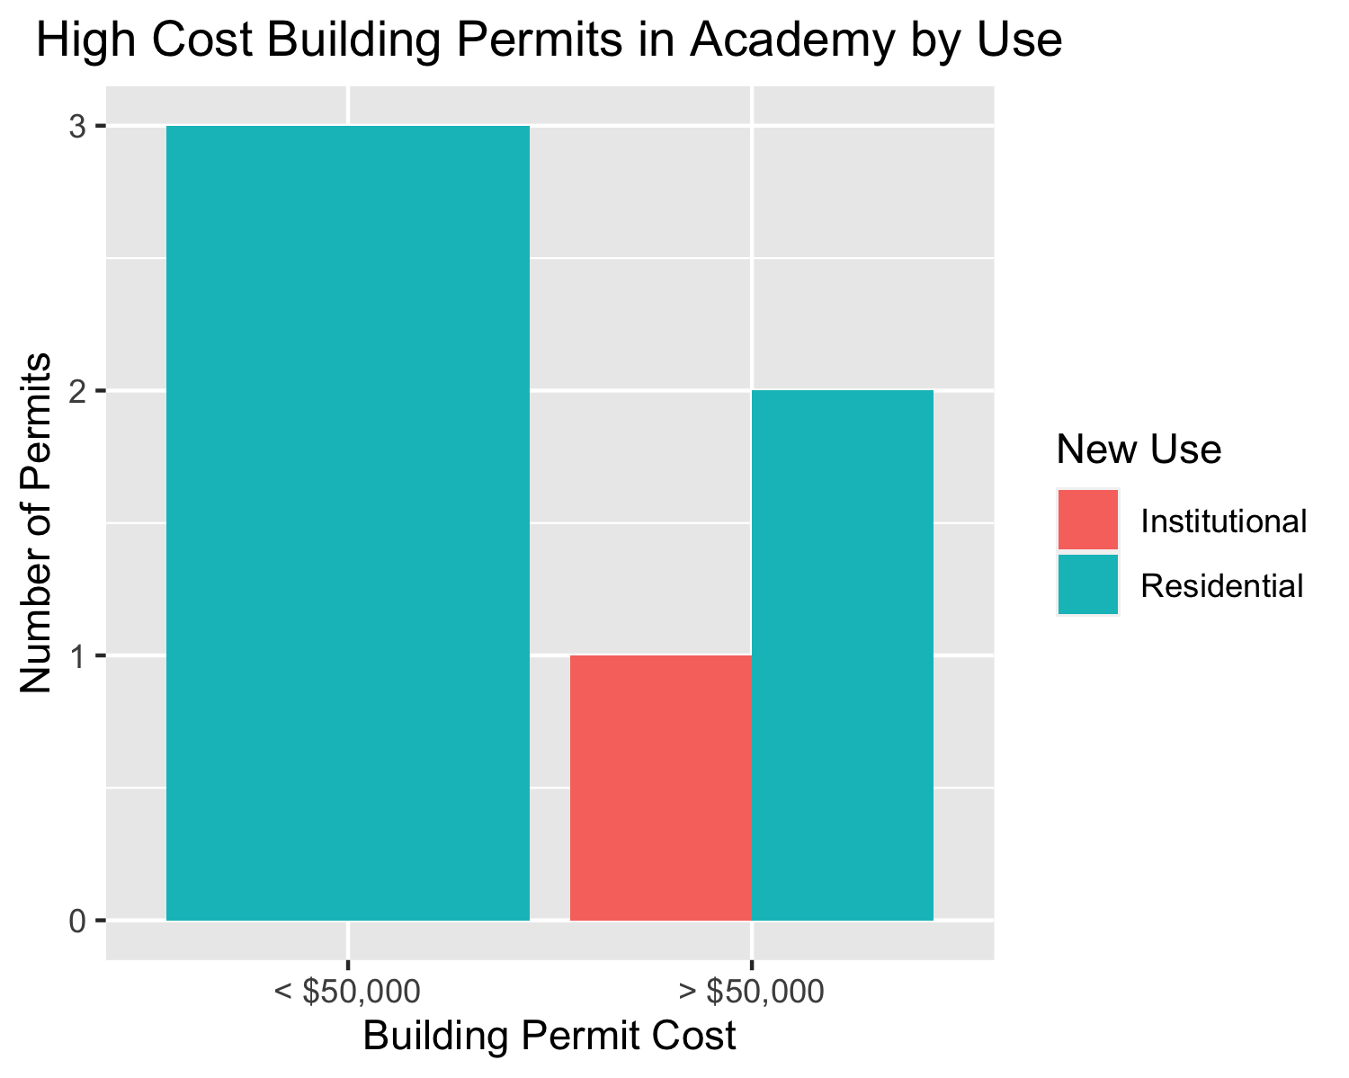

Slide 7
Central West End
40 building permits in Central West End in January 2020

Slide 8
new_use | avg_cost | permit_count
Commercial | 3230000.0 | 5
Industrial | 21676.0 | 1
Institutional | 2948966.6 | 16
Residential | 46999.8 | 18

Slide 9
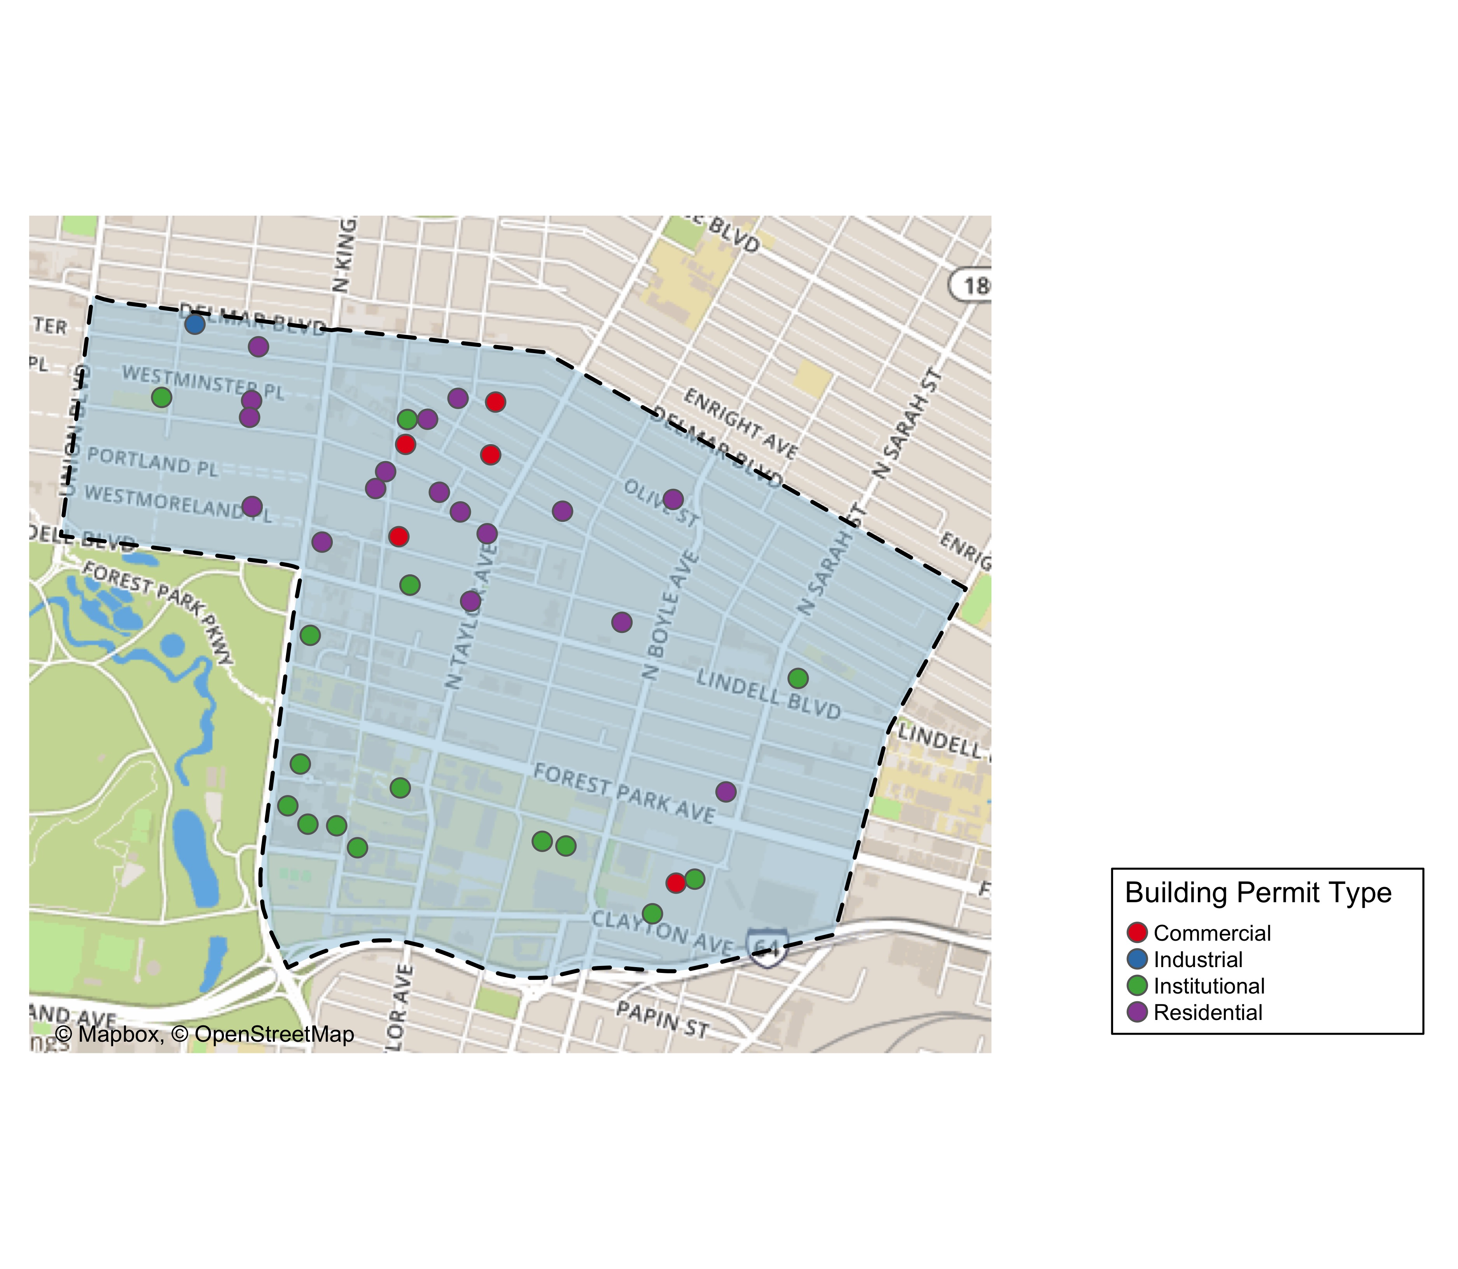

Slide 10
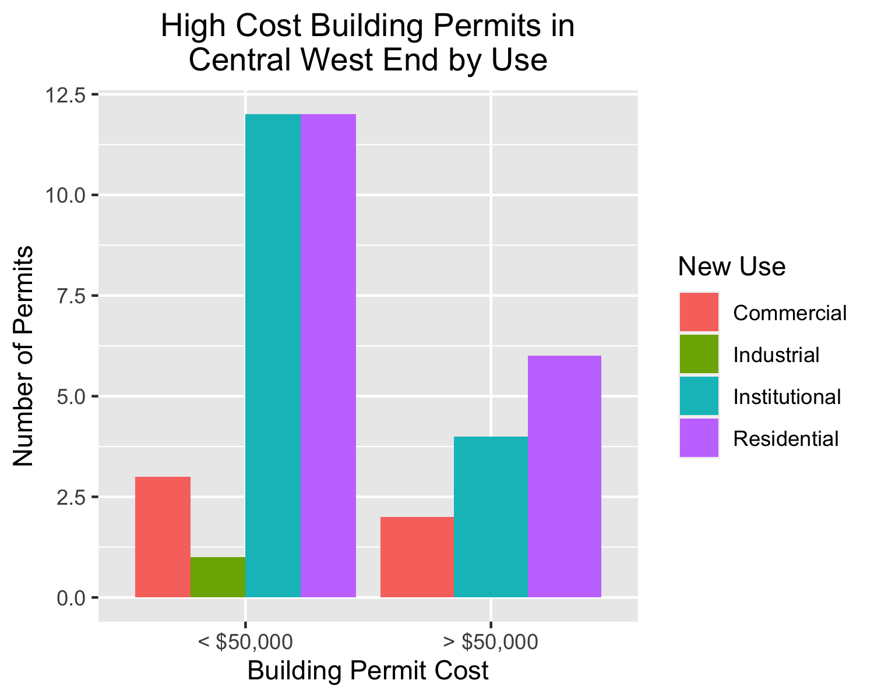

Slide 11
DeBaliviere Place
6 building permits in DeBaliviere Place in January 2020

Slide 12
new_use | avg_cost | permit_count
Institutional | 8000 | 1
Residential | 3608000 | 5

Slide 13
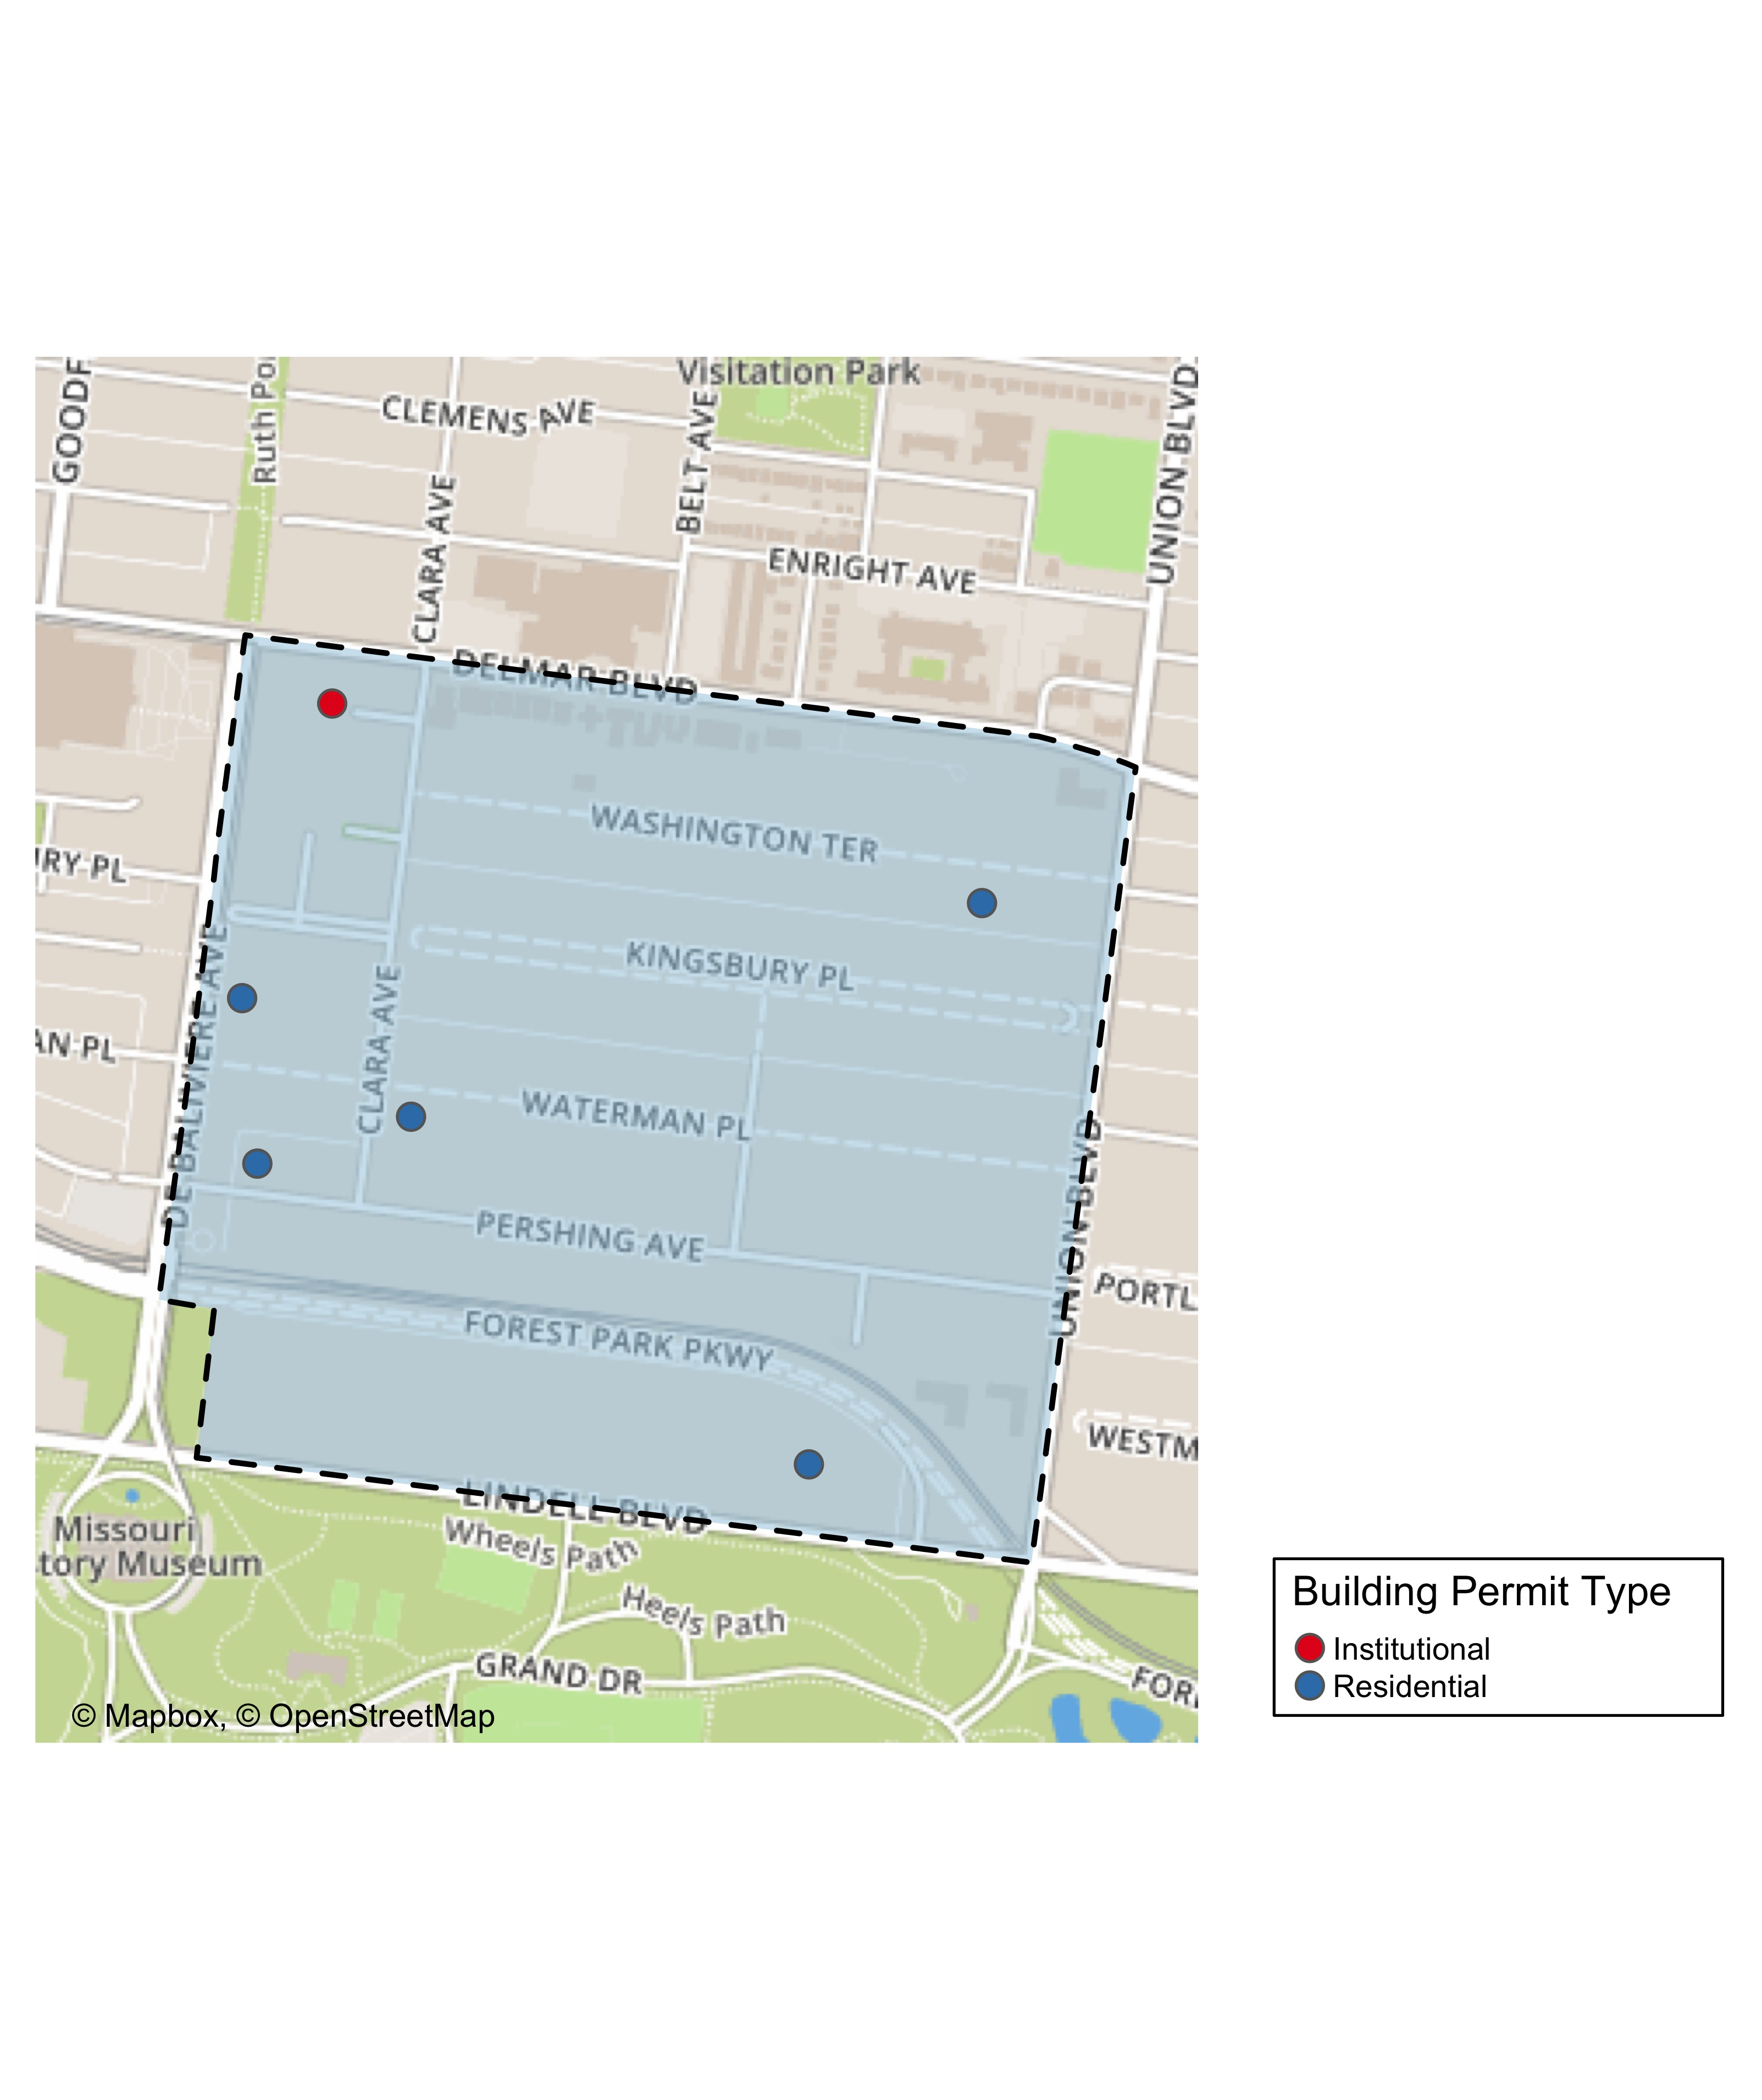

Slide 14
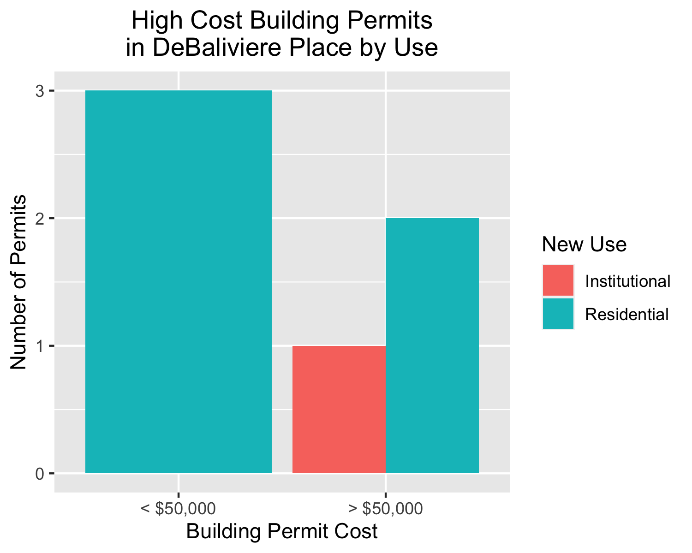

Slide 15
Forest Park South East
13 building permits in Forest Park South East January 2020

Slide 16
new_use | avg_cost | permit_count
Commercial | 17500 | 2
Institutional | 64145 | 1
Residential | 29699 | 10

Slide 17
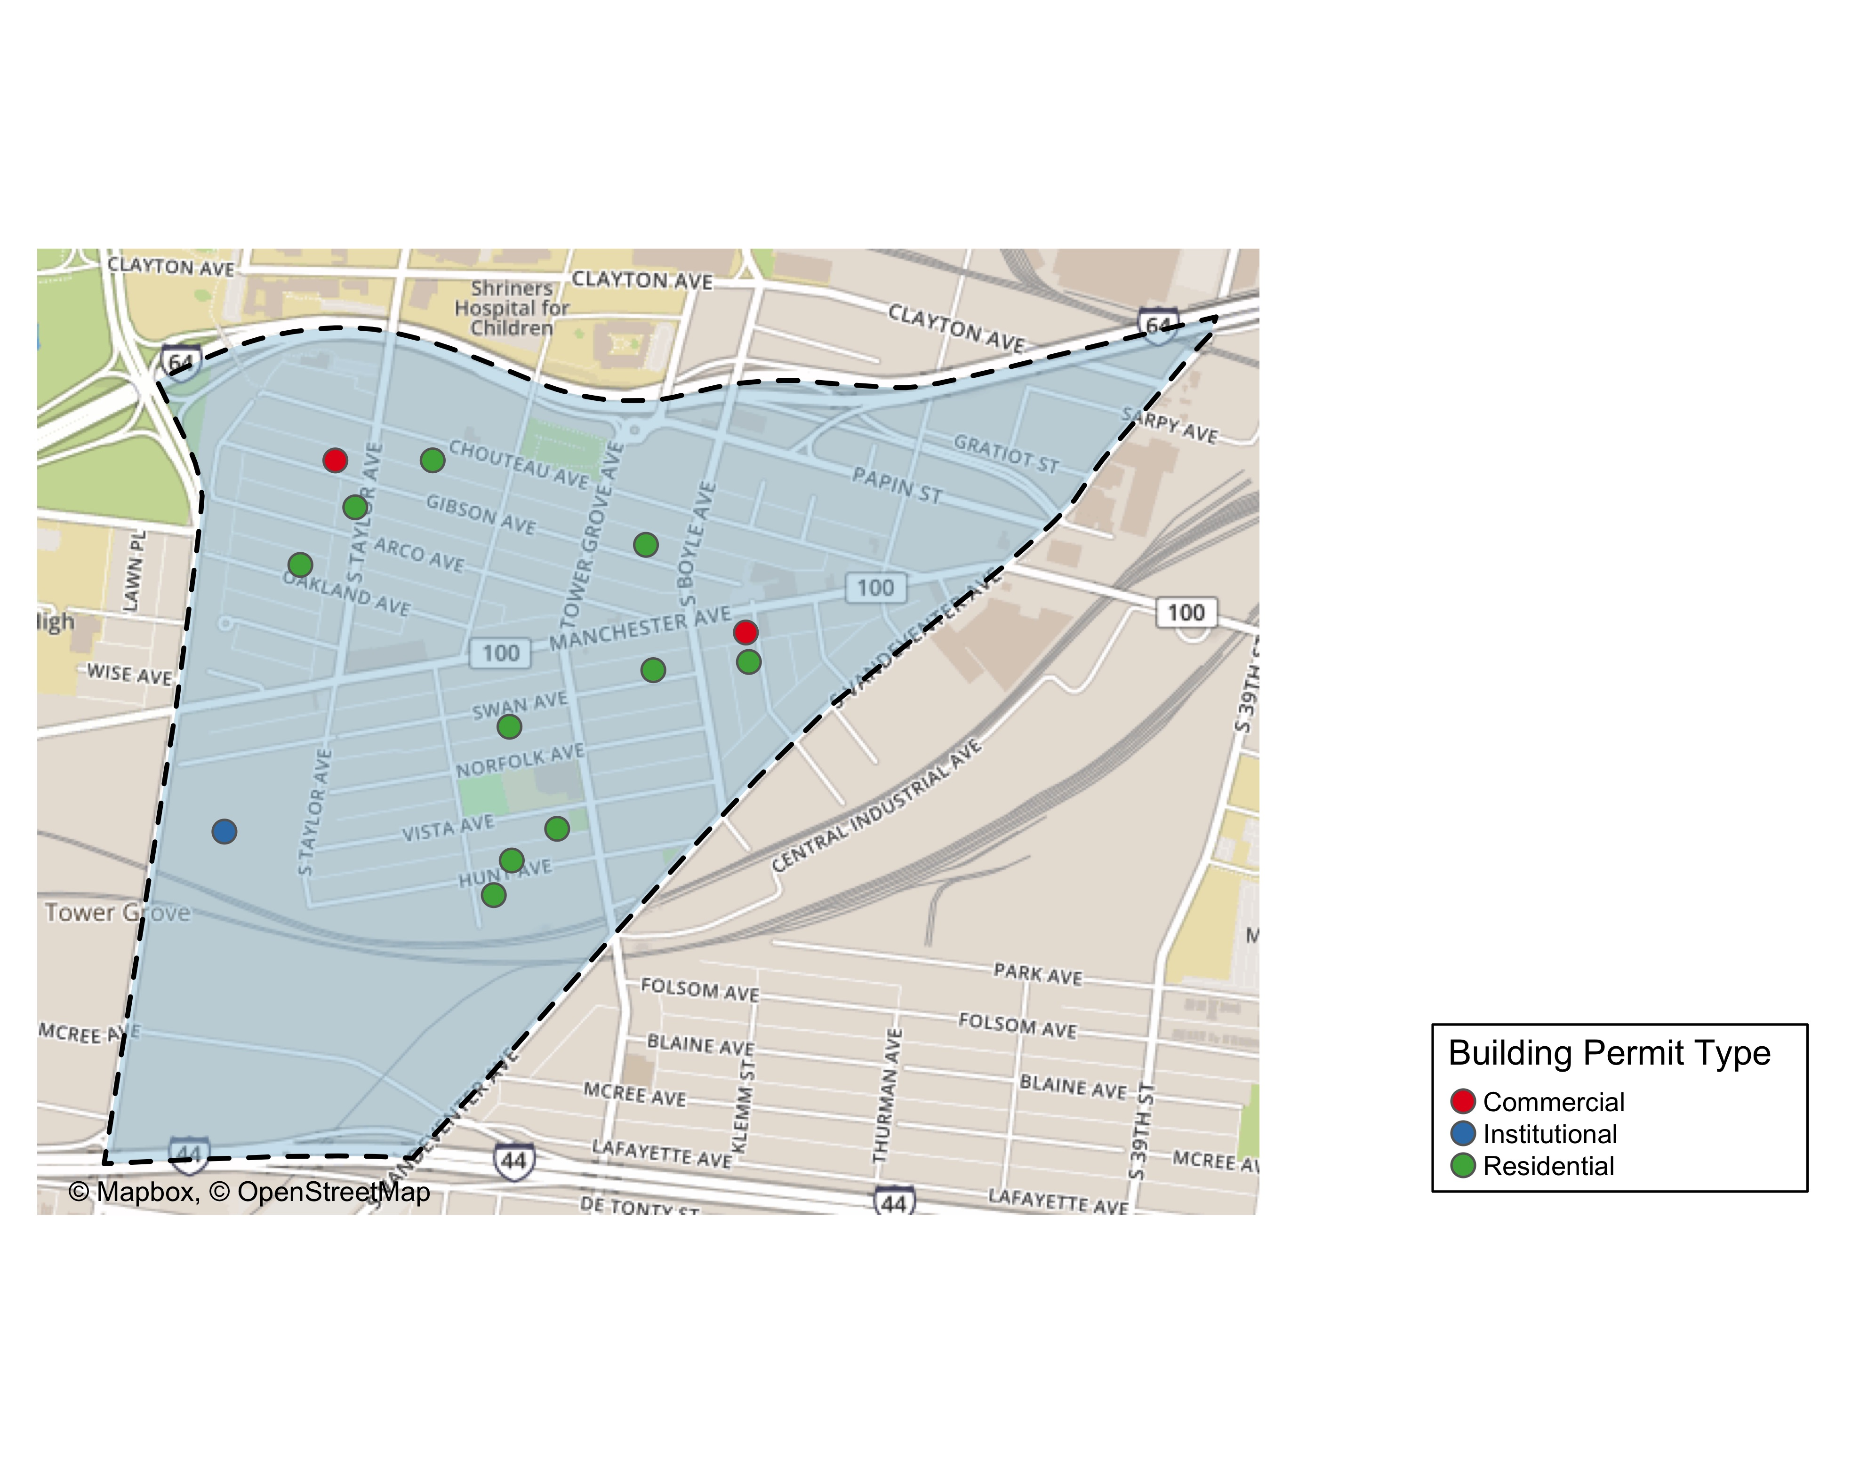

Slide 18
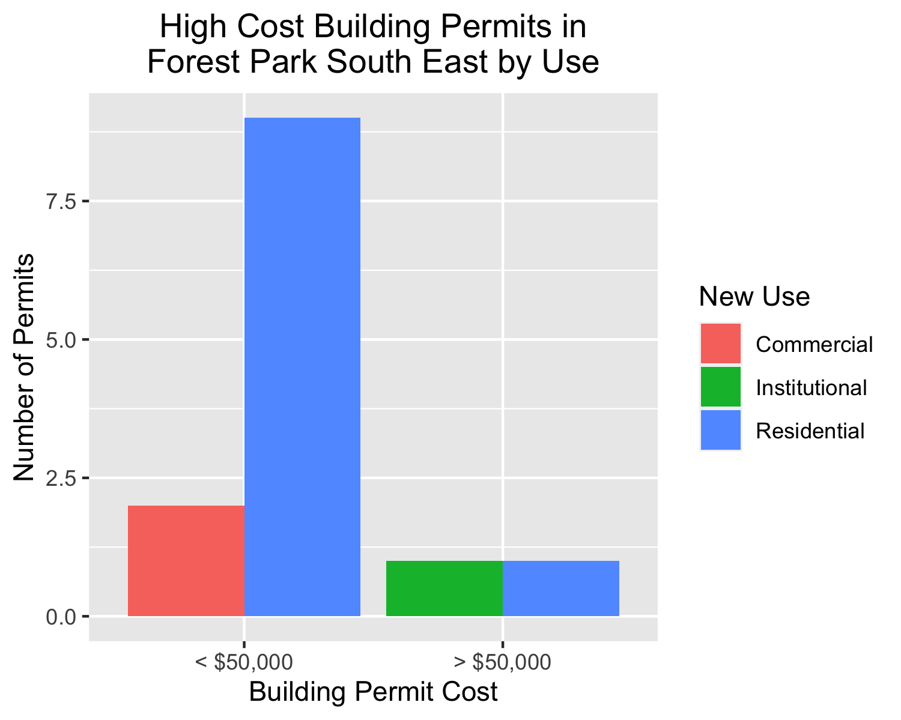

Slide 19
Fountain Park
0 building permits in Fountain Park January 2020

Slide 20
Lewis Place
1 building permits in Fountain Park January 2020

Slide 21
new_use | avg_cost | permit_count
Residential | 2500 | 1

Slide 22
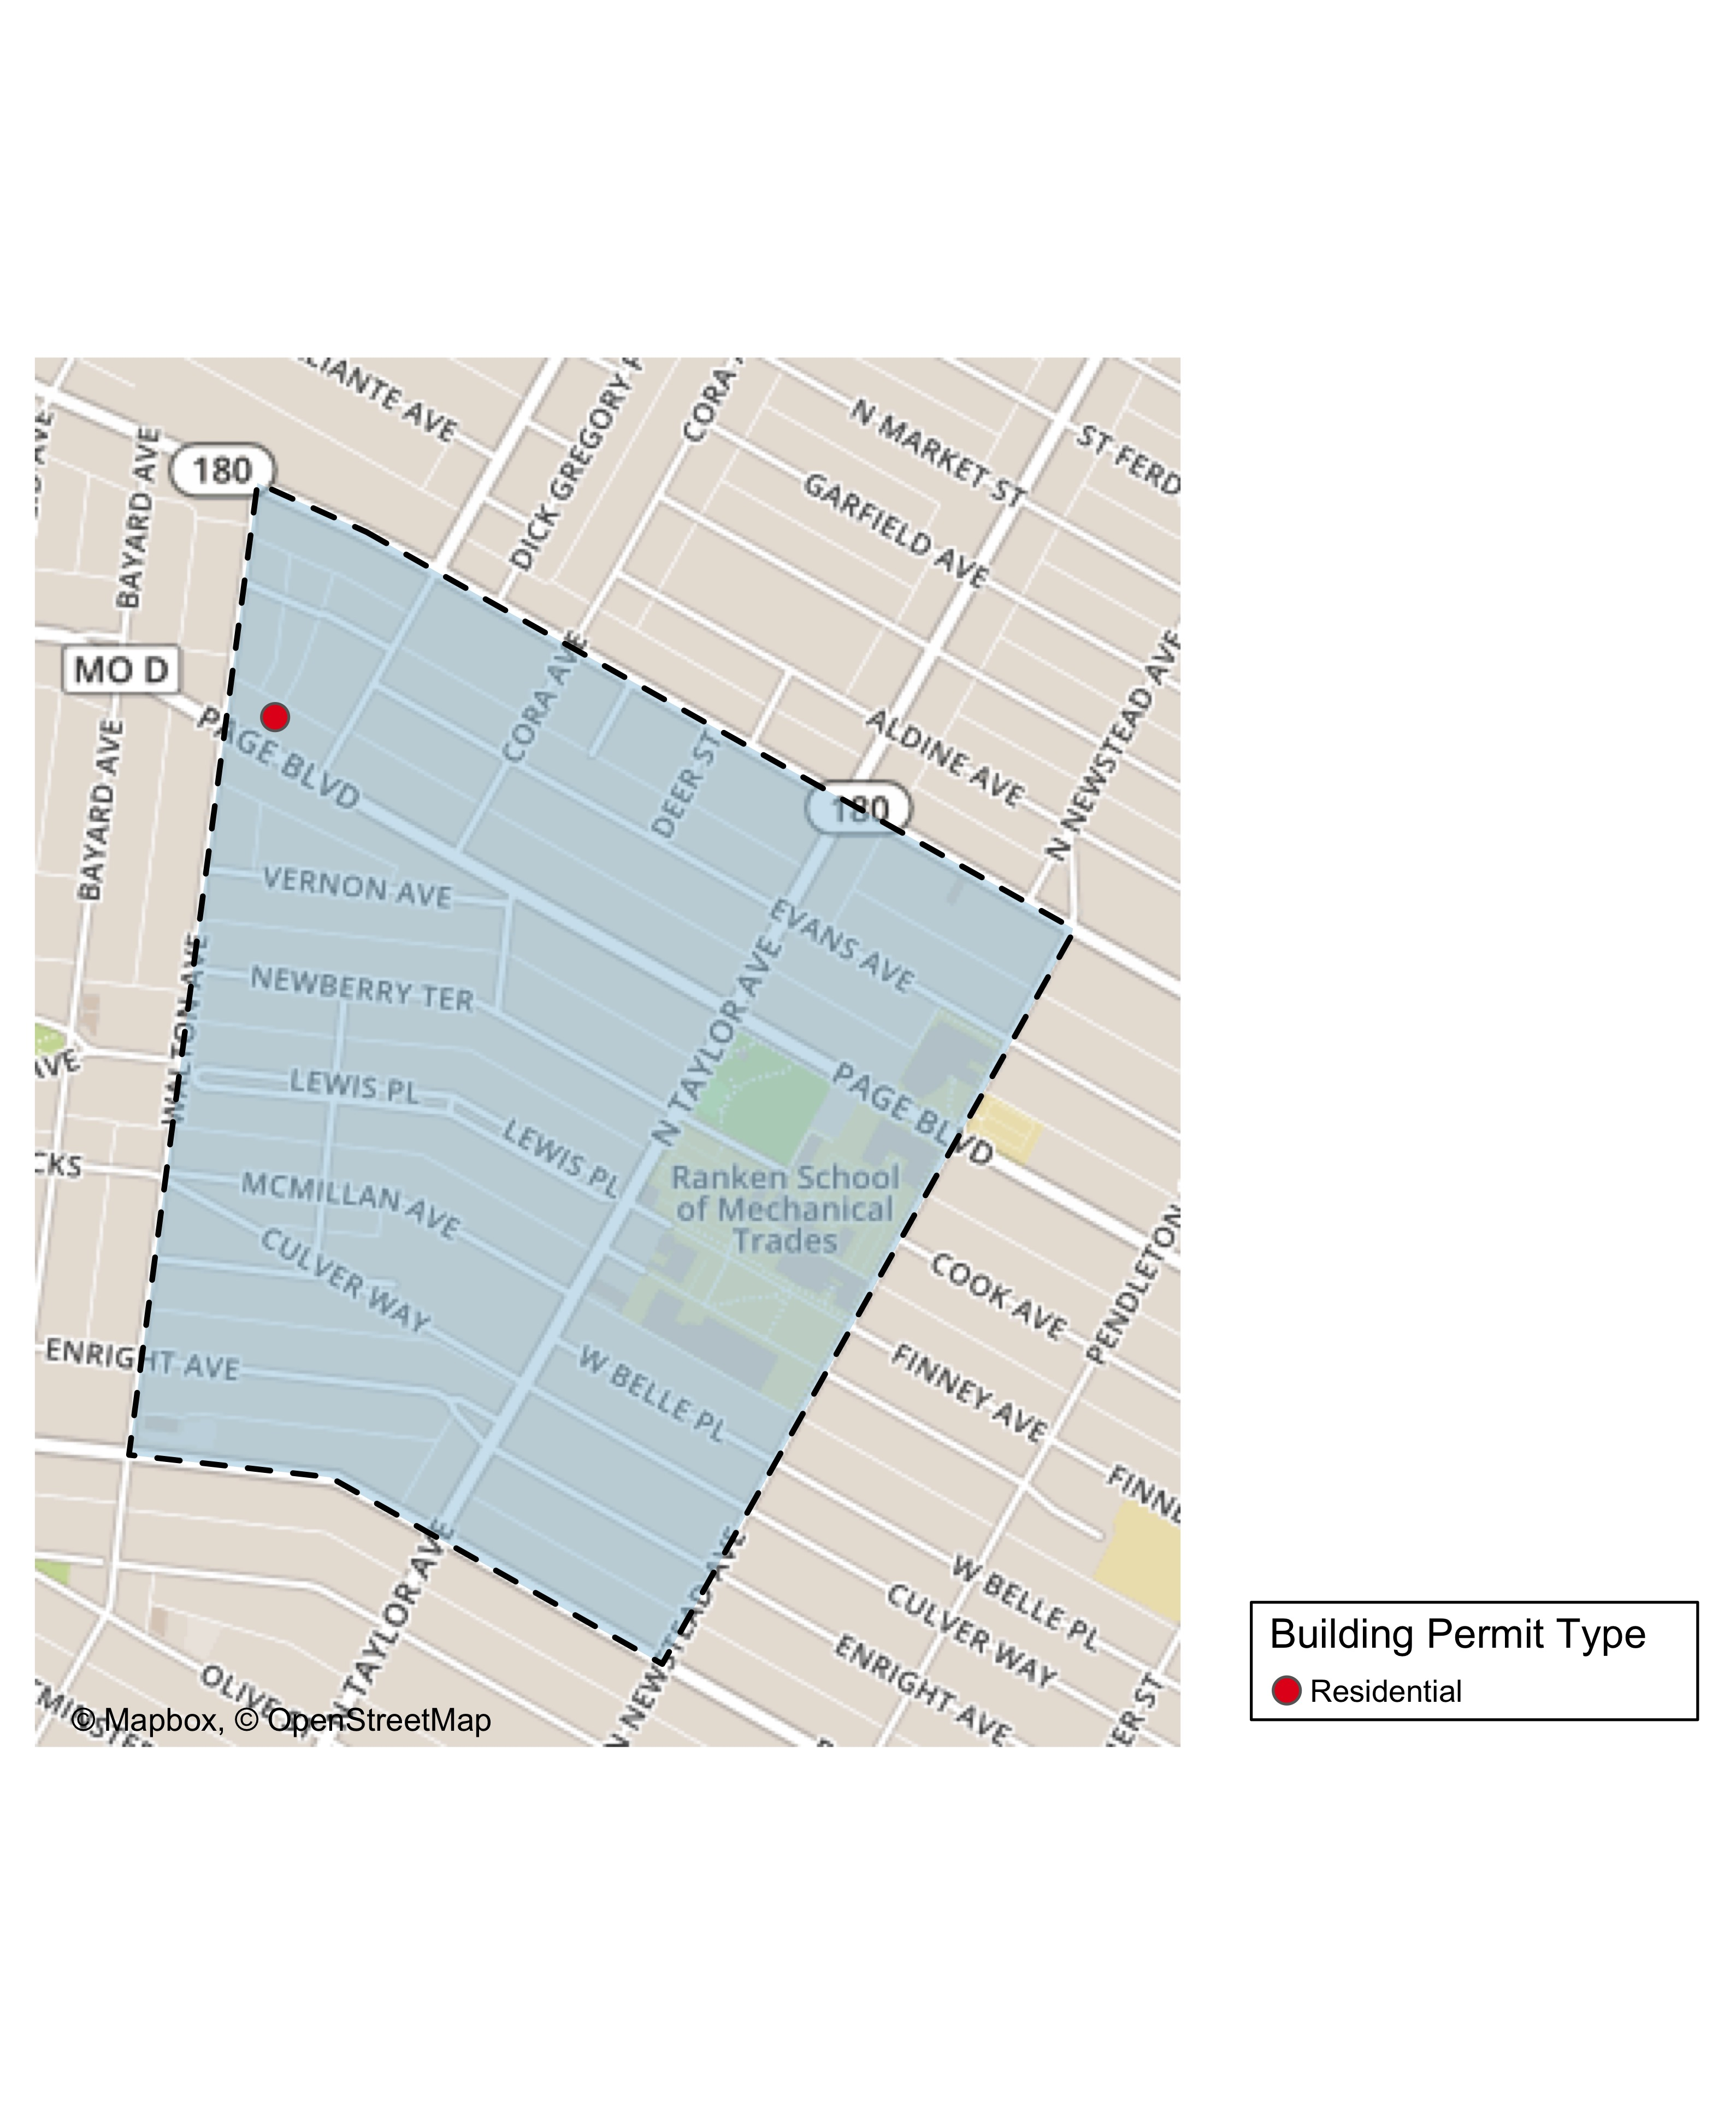

Slide 23
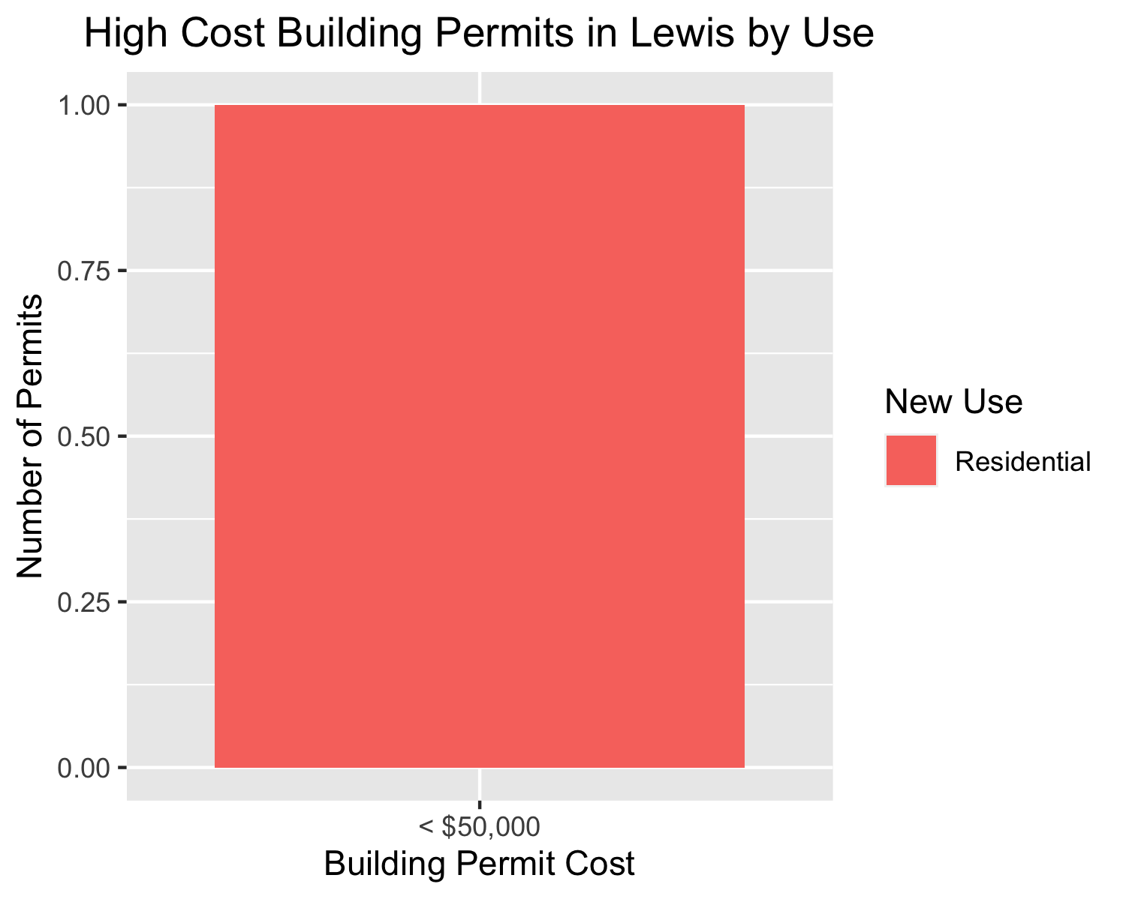

Slide 24
Skinker DeBaliviere
8 building permits in Fountain Park January 2020

Slide 25
new_use | avg_cost | permit_count
Institutional | 5000 | 2
Residential | 30500 | 6

Slide 26
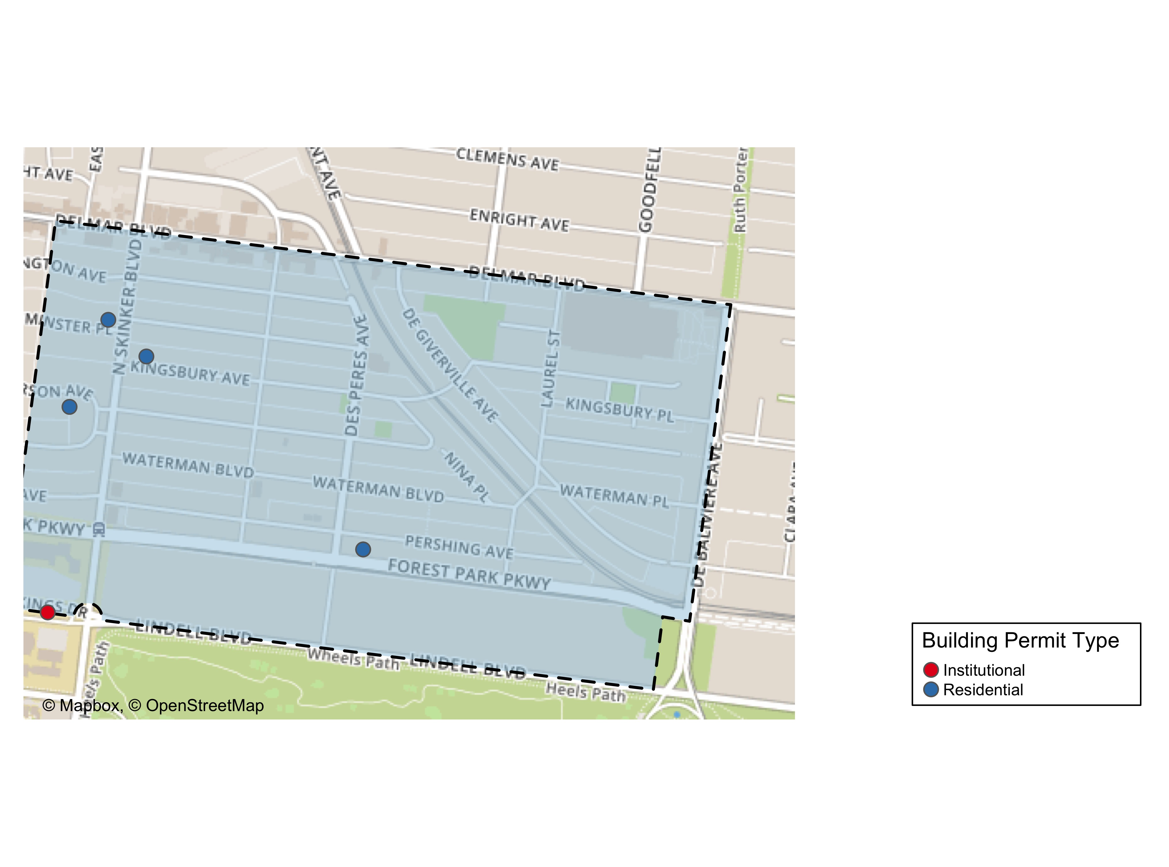

Slide 27
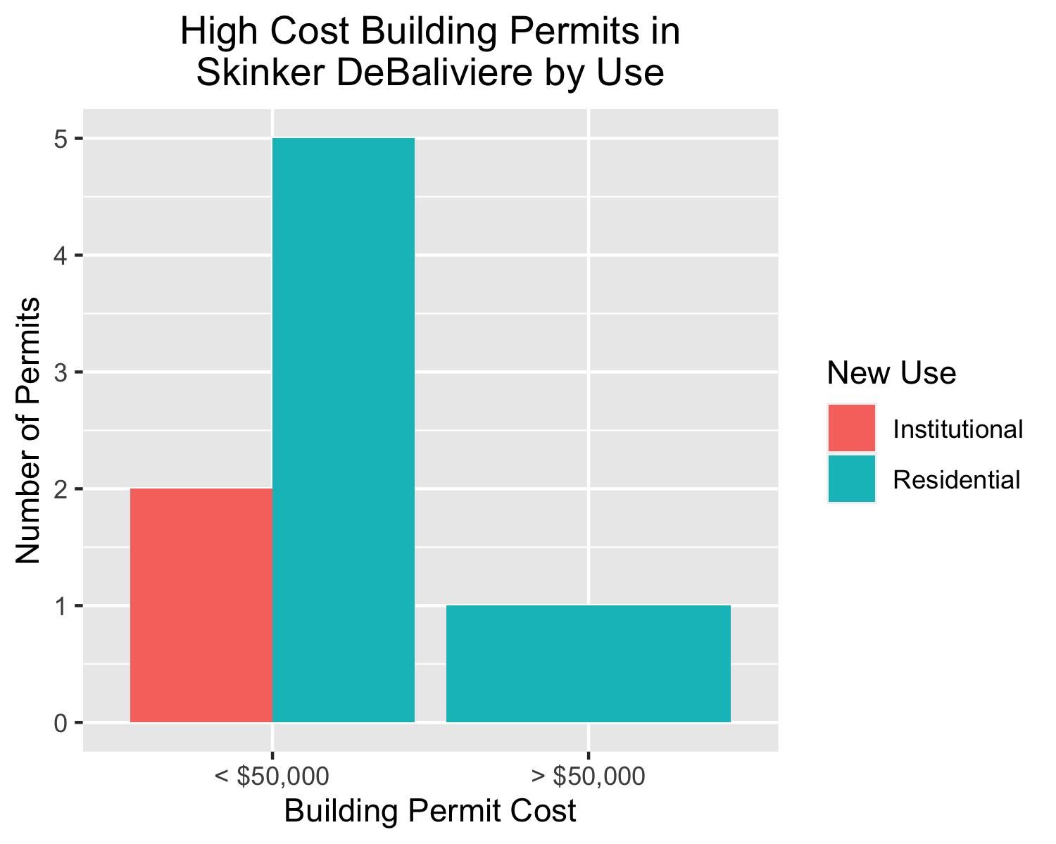

Slide 28
Vandeventer
2 building permits in Fountain Park January 2020

Slide 29
new_use | avg_cost | permit_count
Industrial | 55000 | 1
Residential | 150000 | 1

Slide 30
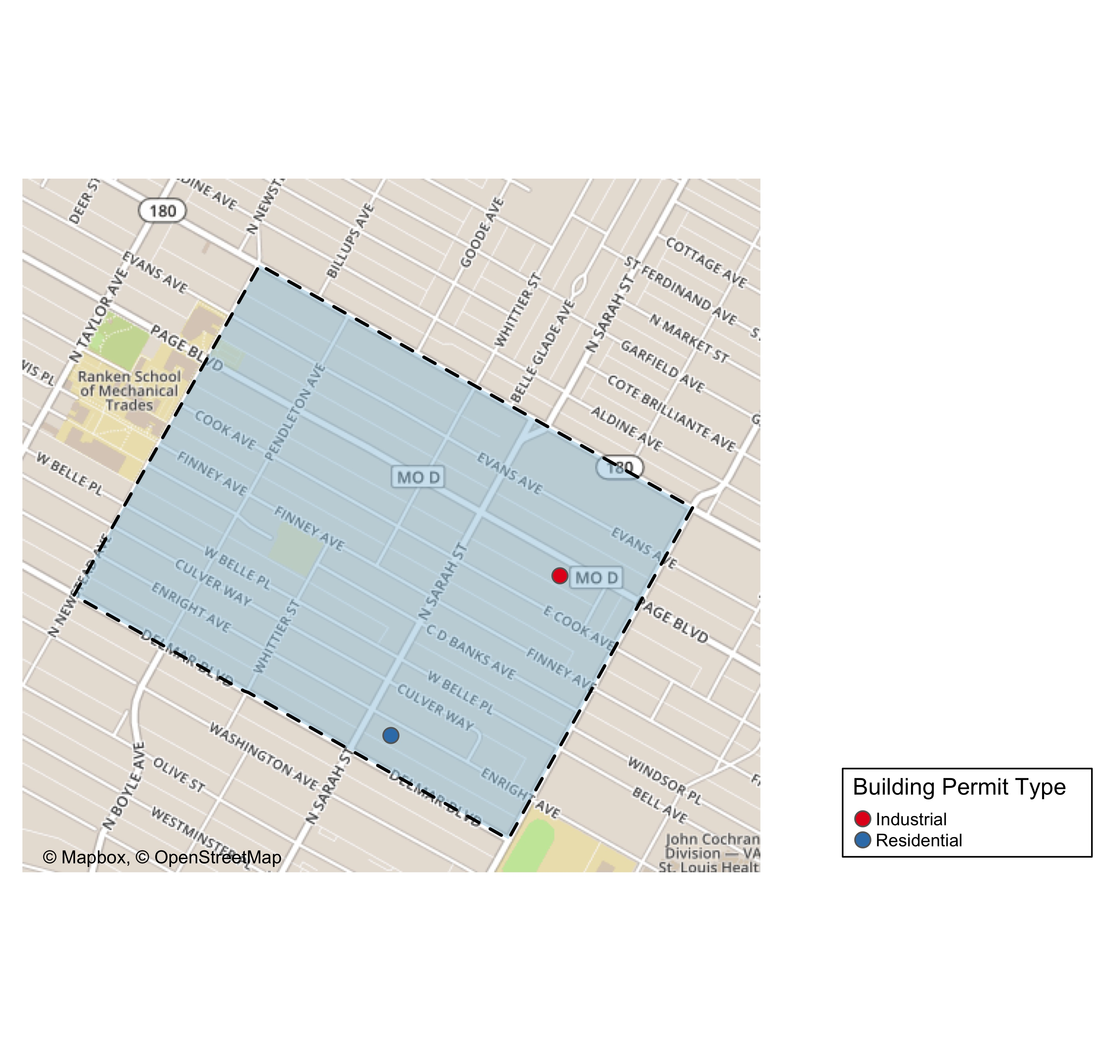

Slide 31
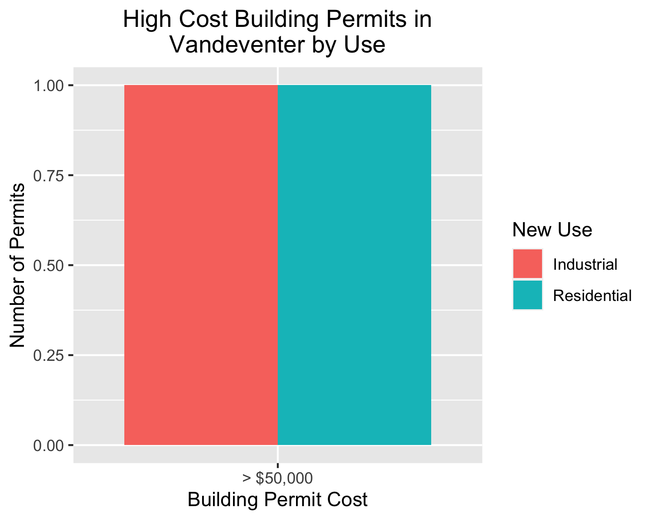

Slide 32
Visitation Park
0 building permits in Fountain Park January 2020

Slide 33
West End
12 building permits in Fountain Park January 2020

Slide 34
new_use | avg_cost | permit_count
Commercial | 14000.000 | 3
Residential | 4222.222 | 9

Slide 35
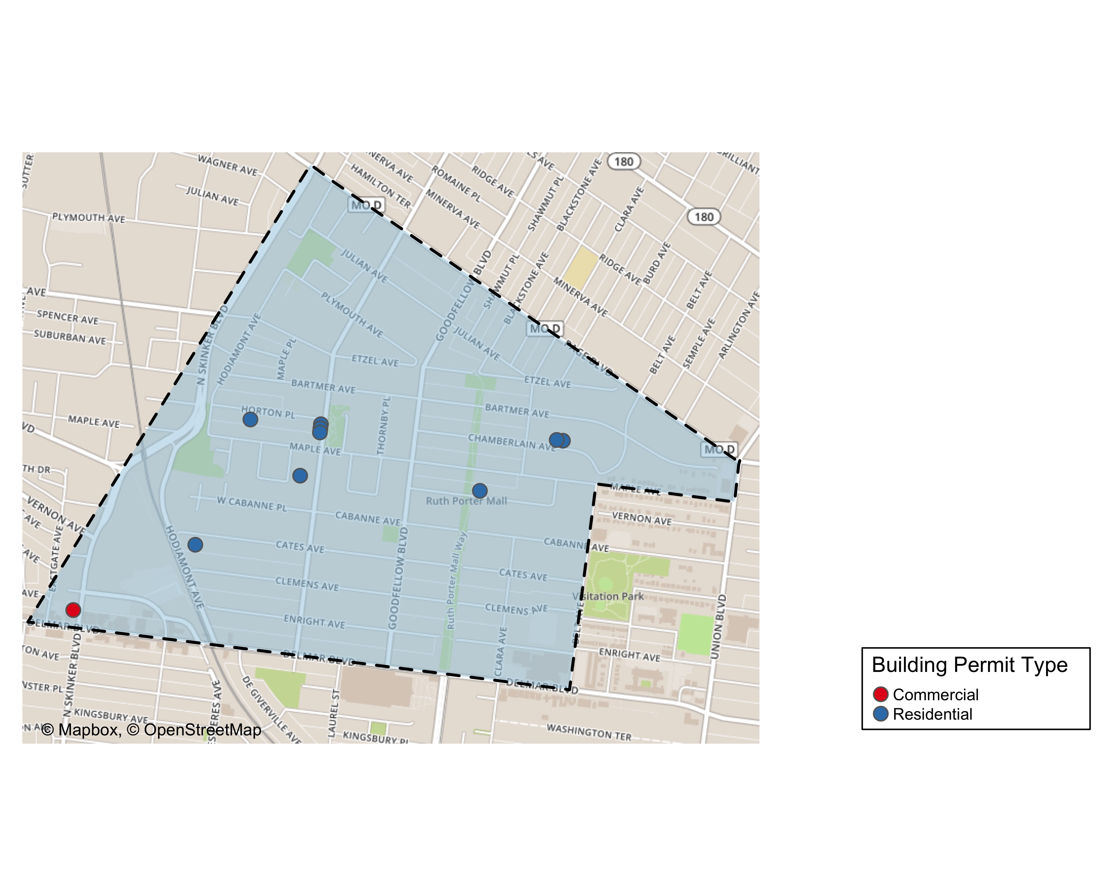

Slide 36
